Slide 1

ION - Hackathon 2020
AiZen – AI Stratification Engine

Slide 2
Agenda
01 | Details of the team [Name, Designation, Practice Area]
02 | Brief explanation of idea & implementation
03 | Technologies used
05 | Support required, if any
06 | Assurance on completion of the idea implementation before the HACKATHON deadlines
07 | Q & A

Slide 3

Detail of Team

Slide 4
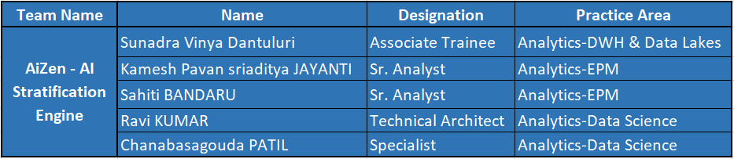
Team - AiZen

Slide 5

Brief explanation of idea & implementation

Slide 6



AiZen Capabilities
AiZen- Interface
Allow secure and reliable platform to perform Data Profiling.
Feature like Training the Classification and Regression Model with smooth UI with great user experience.
Full control to the user regarding feature selection
Application Servers
Allow developer to build easy, reliable application server.
Have capability to scale up using nginx and allow parallel processing.
Data Science
Make data clean, compatible, comparable & reliable, even when it comes from a wide range of unrelated sources
Ensure data is ready for supervised learning and model engineering.

Slide 7


















Industry Verticals
Industry Focus
Service Portfolio
FOODTECH
HITECH
LOGISTICS
RETAIL
ENTERPRISE SOLUTIONS
IT ADVISORY
UTILITIES
TELECOM
OIL & GAS
MAUFACTURING
EMERGING
TECHNOLOGIES
ITSM
SOLUTIONS
MEDIA
ENTERTAINMENT
FINANCIAL
TRANSPORT
IT CONSULTING & STAFFING
HARDWARE
RESELLER

Slide 8
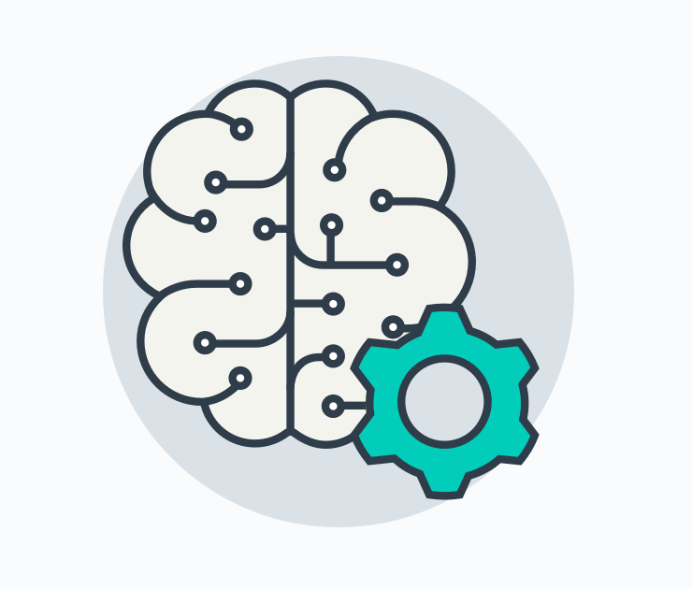
Technologies
Used

Slide 9
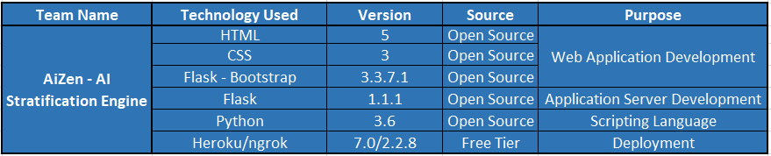
Technologies Used

Slide 10

Support
required

Slide 11
Support Required

Slide 12

Assurance of
Completion

Slide 13
Document to track the Development

Slide 14

Q & A

Slide 15


AiZen

